Slide 1
Welcome!
Please, have a seat.
CWRU Quants
quants@case.edu
Notes:
CHristo

Slide 2
AGENDA
Placement Updates
What is an Election Market?
Volatility From Election Events
Arbitrage Opportunities
Modeling Inefficiencies
Notes:
Christo

Slide 3

Clarity Markets Growth Intern
(Clarity is a startup in the prediction market space)

Slide 4
Intro to Election Markets
Notes:
Christo

Slide 5
Who has heard of Kalshi, Polymarket, PredictIt?

Slide 6
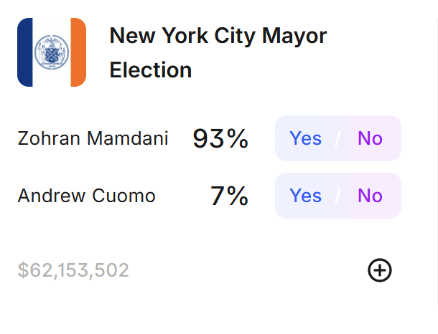
What exactly are these markets?
US-regulated markets that essentially trade probabilities of real life events happening (Yes/No)
If a contract is $0.65, the market thinks there is a 0.65 probability that the event happens

Slide 7
How exactly do these “bets” work?
From the previous slide, if you think Zohran Mamdani will win the NYC mayoral election, you’d buy the “Yes” share, when the share expires, you’ll either be paid $1 if you guessed correctly, or lose the initial money you bought that share for
There is a clear connection to options here

Slide 8
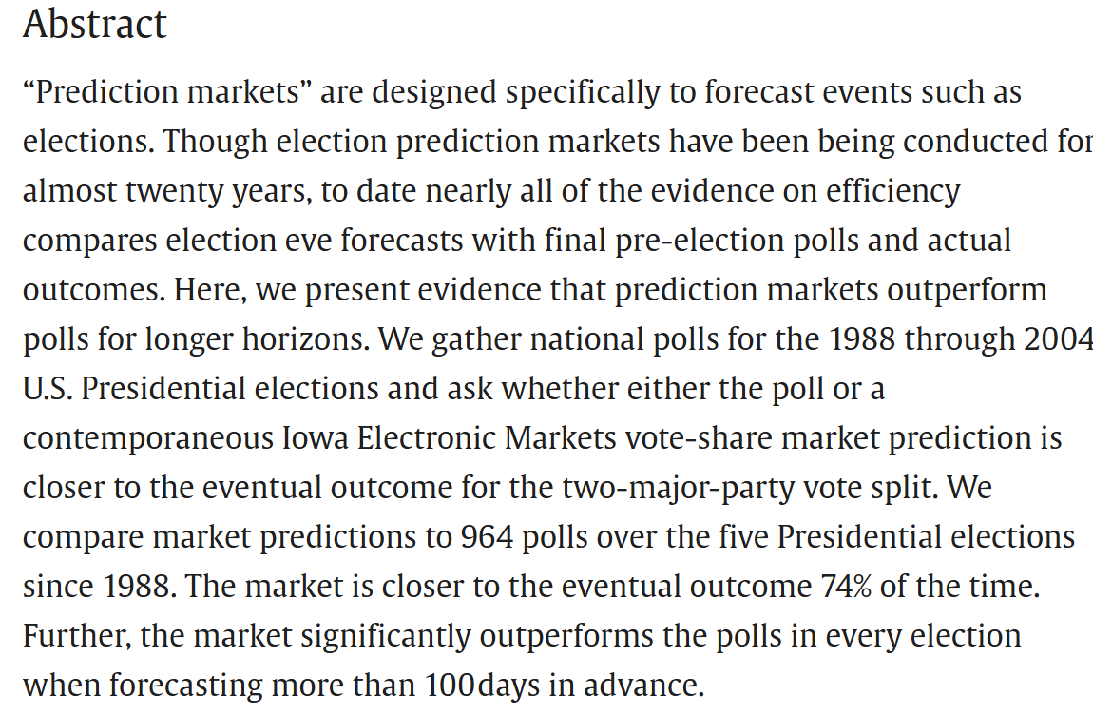
Why do we care?
They are fairly new markets, with a recent craze
These markets are highly inefficient, they present a lot of arbitrage opportunities

Slide 9
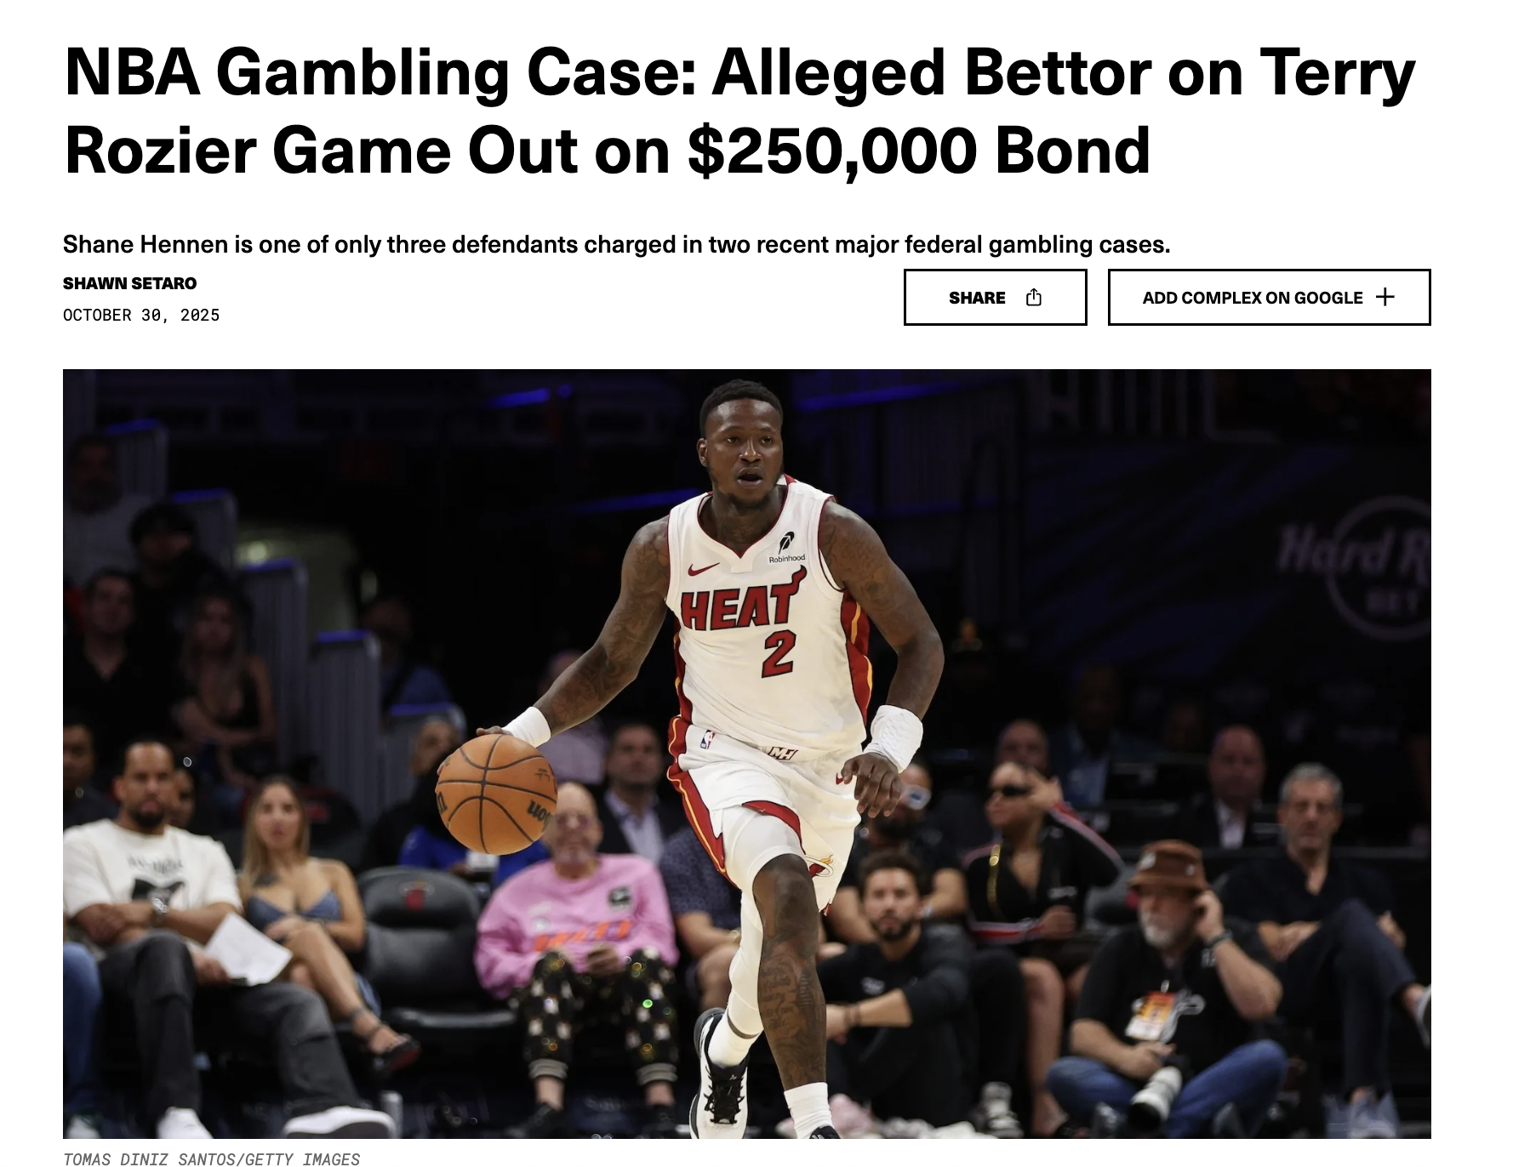
This is also the first time where retail traders can have real moments of “insider trading”
Some people can directly influence the markets, and as a result, disrupt the “integrity” of these betting lines.

Slide 10
Volatility From Election Events
Notes:
Gus

Slide 11
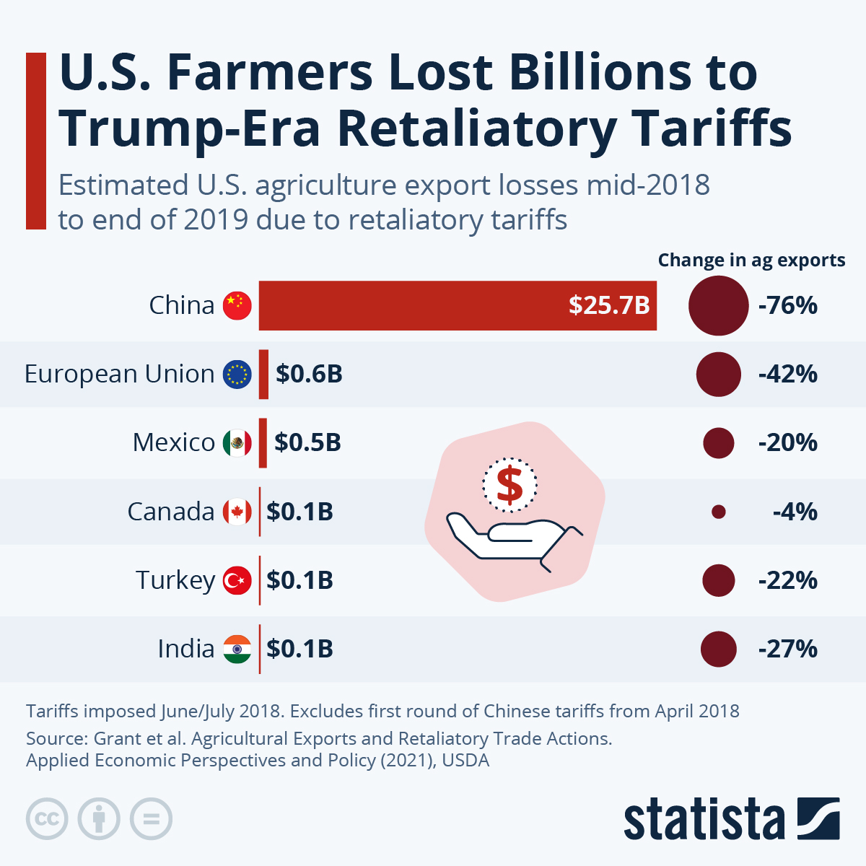
Donald Trump, Election & Tariffs 2018
• Following the 2016 U.S. election, Donald Trump campaigned on protectionist trade policies.
• In March 2018, his administration announced tariffs on steel (25%) and aluminum (10%) imports under Section 232.
• This triggered fears of a global trade war, especially with China, Canada, and the EU.

Slide 12
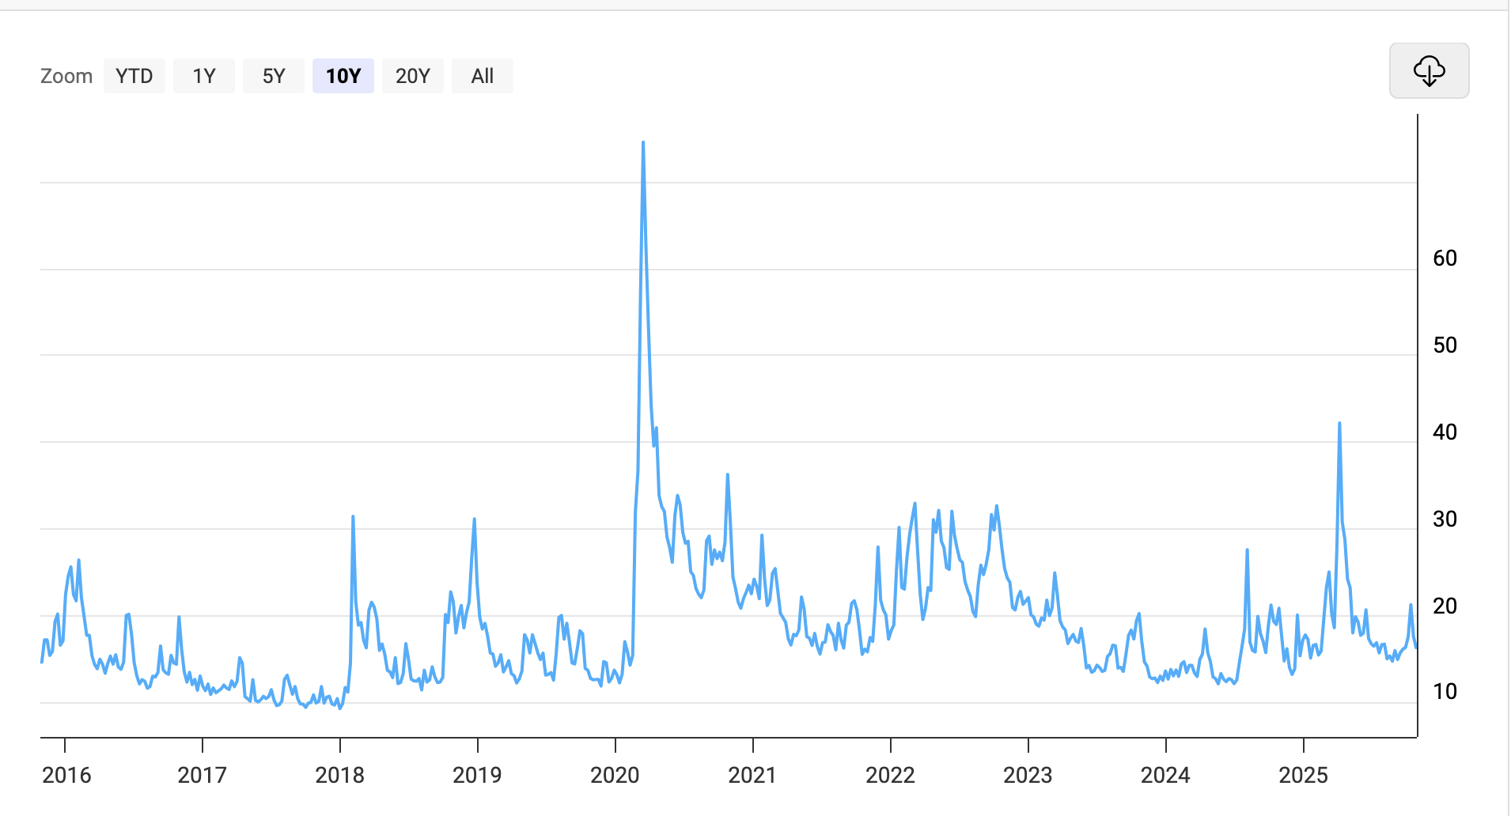
Donald Trump, Election & Tariffs 2018
CBOE VIX Volatility
Clearly there was a spike in Early 2018 when the Steel and Aluminum tariffs were launched

Slide 13
Arbitrage Opportunities
Notes:
Gus

Slide 14
arbitrage (n): the nearly simultaneous purchase and sale of securities of foreign exchange in different markets in order to profit from price discrepancies (Merriam Webster).

Slide 15
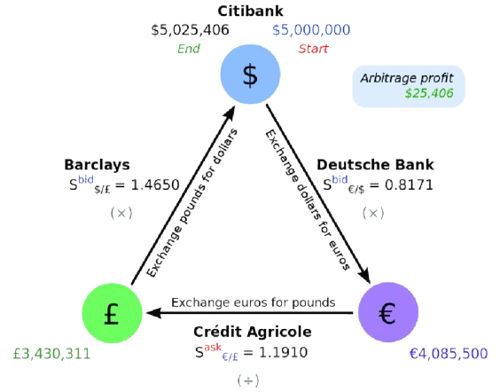
Arbitrage…from finance standpoint
Arbitrage is basically free money!*
Assets may be priced differently in markets. This can be exploited!
Buy the asset in the market where it is undervalued.
Sell the same asset in the market where it is overvalued.
The difference between the buying and selling prices represents the arbitrage profit.
‹#›

Slide 16
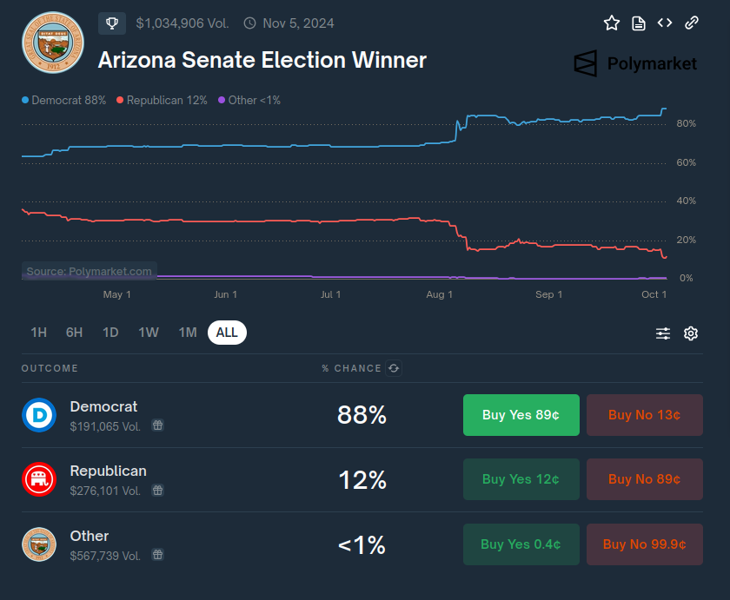
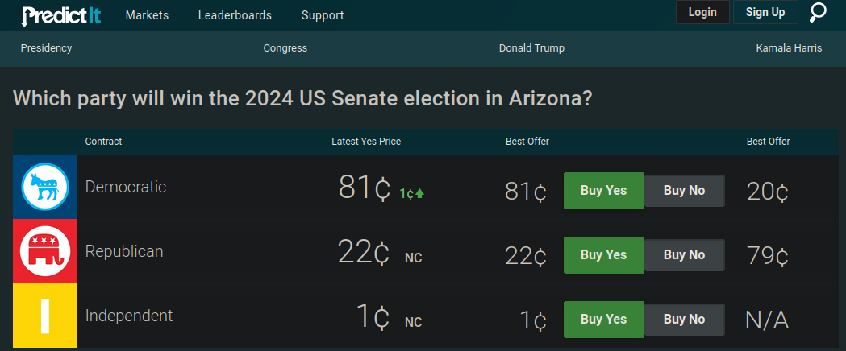
Arbitrage Opportunities:
AZ Senate 2024

Slide 17
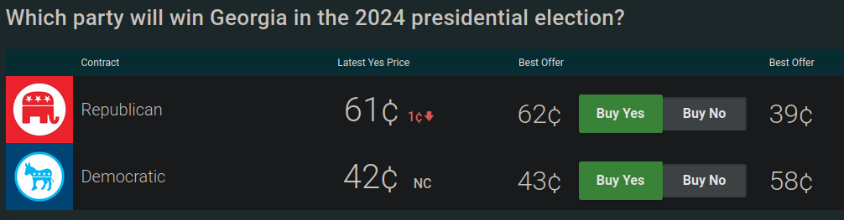
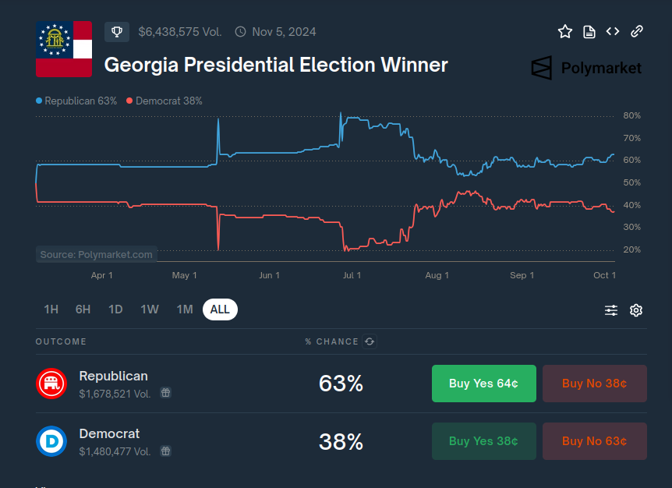
Obstacles to Arbitrage
Trade size limits on major exchanges (ex. $850 cap on investments per trader per question on PredictIt)
Illiquidity
Slippage
Commissions and fees
All of this puts a constraint on the minimum size of a viable arb trade (ex. a 1 or 2 cent profit trade is generally never viable)

Slide 18
Modeling Market Inefficiencies
Notes:
Christo

Slide 19
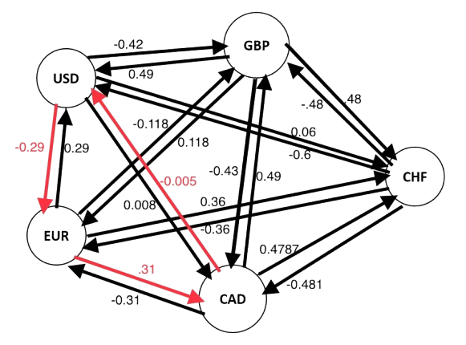
Arbitrage using Bellman-Ford
The Bellman-Ford algorithm is a graph algorithm used to find the shortest paths from a single source vertex to all other vertices in a weighted graph.
It is particularly useful for graphs with negative weight edges, which Dijkstra's algorithm cannot handle.
Additionally, it can detect if there is a negative weight cycle in the graph (a cycle whose sum of edge weights is negative), in which case no solution exists.
If the algorithm finds a negative cycle, it indicates the presence of an arbitrage opportunity. The negative cycle represents a sequence of currency conversions that results in a net gain.

Slide 20
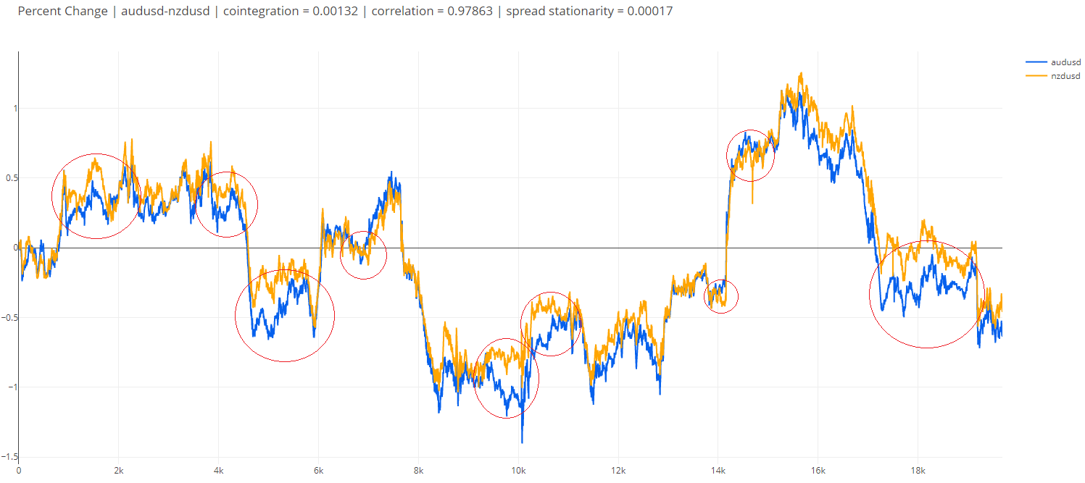
Statistical Arbitrage
Highly technical and computational approach to arb
Instead of the same security being traded on different markets, two or more highly correlated securities are traded on the same market to take advantage of inefficient relative pricing while maintaining market neutrality
The strategy relies on mean reversion - it assumes that price divergence between the assets will tend toward 0 instead of further expanding
In practice, these price divergences might only last for small fractions of a second - that’s where HFT comes into play

Slide 21
Summary
Prediction markets are a new, developing form of exchange
Despite this, they resemble other market structures that we’ve discussed (options, futures, etc.)
They are INEFFICIENT, meaning that they don’t have all information “priced in” since they are much more psychological and have “insider trading”
During elections, this provides even more opportunities
This presents opportunity for arbitrage

Slide 22



Social Links
@cwruquants
@cwruquants
@cwruquants
Notes:
CHristo

Slide 23
QUESTIONS
AND ANSWERS
Contact us!
Email: quants@case.edu
Instagram: @cwruquants
Notes:
Sid

